Slide 1
Capstone Engagement
Assessment, Analysis, and Hardening of a Vulnerable System

Slide 2
Table of Contents
This document contains the following sections:
01
Network Topology
02
Red Team: Security Assessment
03
Blue Team: Log Analysis and Attack Characterization
Hardening: Proposed Alarms and Mitigation Strategies
04

Slide 3
Network Topology
‹#›

Slide 4
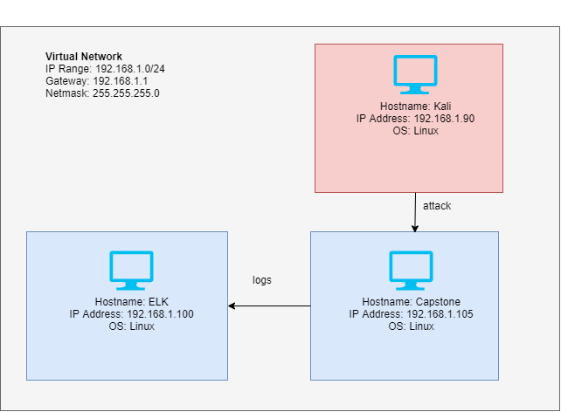
Network Topology

Slide 5

Red Team
Security Assessment
‹#›

Slide 6
Recon: Describing the Target
Nmap identified the following hosts on the network:
Hostname | IP Address | Role on Network
Default Gateway | 192.168.1.1 | This is the default gateway of the virtual network
ELK | 192.168.1.100 | ELK stack server. This receives logs from the capstone machine and visualises it in kibana.
Capstone | 192.168.1.105 | Capstone is the target machine of this engagement. It contains sensitive data.
Kali | 192.168.1.90 | Kali is the machine used to attack capstone in this engagement.

Slide 7
Vulnerability Assessment
The assessment uncovered the following critical vulnerabilities in the target:
Vulnerability | Description | Impact
Webdav PHP Reverse Shell | A payload that listens listens for a shell connection from the attacker once activated. | Allows an attacker to open a reverse shell on the system. Search and obtain sensitive data on system.
Sensitive data exposure | Inadvertently revealing sensitive information. | Revealed location of secret folder and login username or said folder. Allows attackers to easily brute force into the folder and obtain additional information within.
Brute force vulnerability | A brute force attack can be used to obtain valid usernames and passwords | Gaining access into protected areas. Gaining credentials of user account.

Slide 8
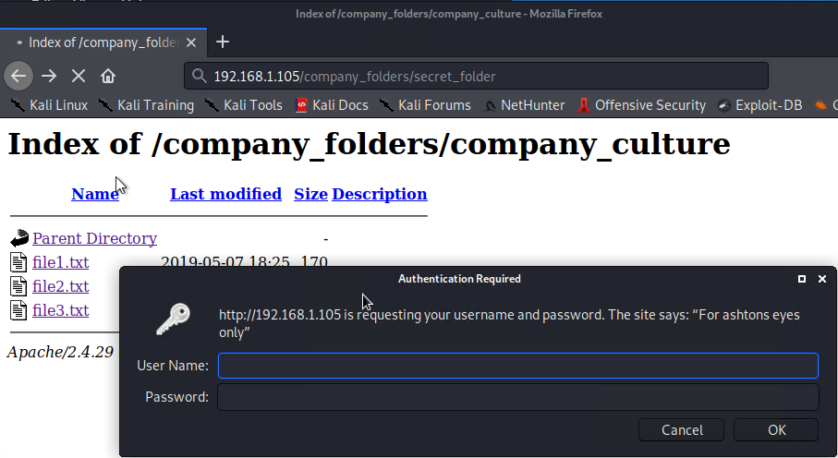
Exploitation: Sensitive Data Exposure
01
02
03
Tools & Processes
After performing nmap scans to reveal location of capstone and that it is reachable through http we used the web browser to access the website.
Browsing the website we discover the secret folder.
The secret folder’s login form reveals ashton is the login user.
Achievements
Allowed access to website and finding out company staff names and roles within the company.
Located a secret folder.
Obtained username for secret folder credential.
Nmap 192.168.1.0/24

Slide 9
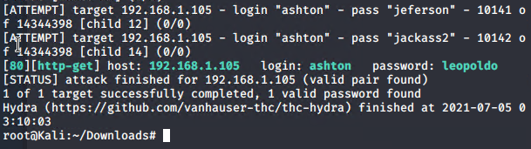
Exploitation: Brute Force Vulnerability
01
02
03
Tools & Processes
Hydra - A tool used to brute force logins.
Rockyou.txt - A large list of passwords widely used and obtainable online.
https://crackstation.net - Online website that can take a hash and decrypt it.
Achievements
Gain successful login and access to secret folder.
Obtained Ryan’s password hash.
Obtained instructions to access webdav
Obtain Ryan’s password.
hydra -l ashton -P /usr/share/wordlists/rockyou.txt -s 80 -f -vV 192.168.1.105 http-get /company_folders/secret_folder

Slide 10
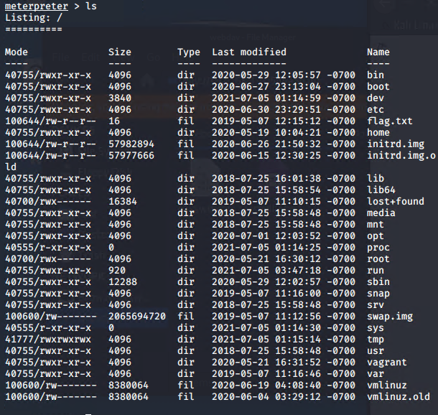
Exploitation: [Name of Third Vulnerability]
01
02
03
Tools & Processes
Msfvenom to create a reverse shell payload
Metasploit to gain a meterpreter shell
Webdav access deliver payload
Achievements
Obtained a reverse shell.
Obtained sensitive data flag.txt
[INSERT: screenshot or command output illustrating the exploit.]

Slide 11

Blue Team
Log Analysis and Attack Characterization
‹#›

Slide 12
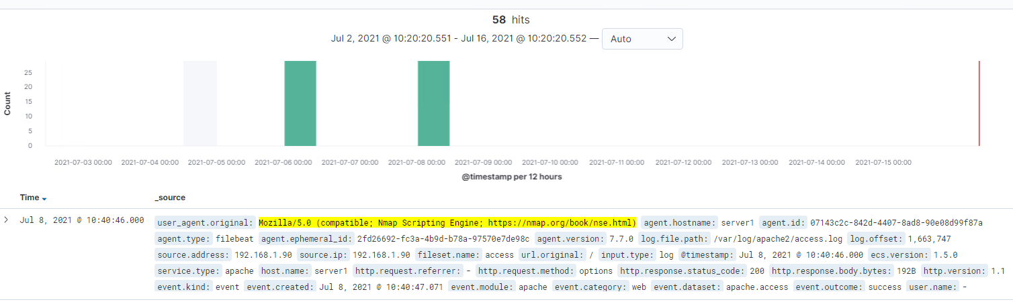

Analysis: Identifying the Port Scan
Answer the following questions in bullet points under the screenshot if space allows. Otherwise, add the answers to speaker notes.
[Insert Here]
Include a screenshot of Kibana logs depicting the port scan.
Jul 8 2021 06:00:00 and Jul 8 2021 08:00:00
58 packets sent
The user agent indicates nmap scripting engine

Slide 13
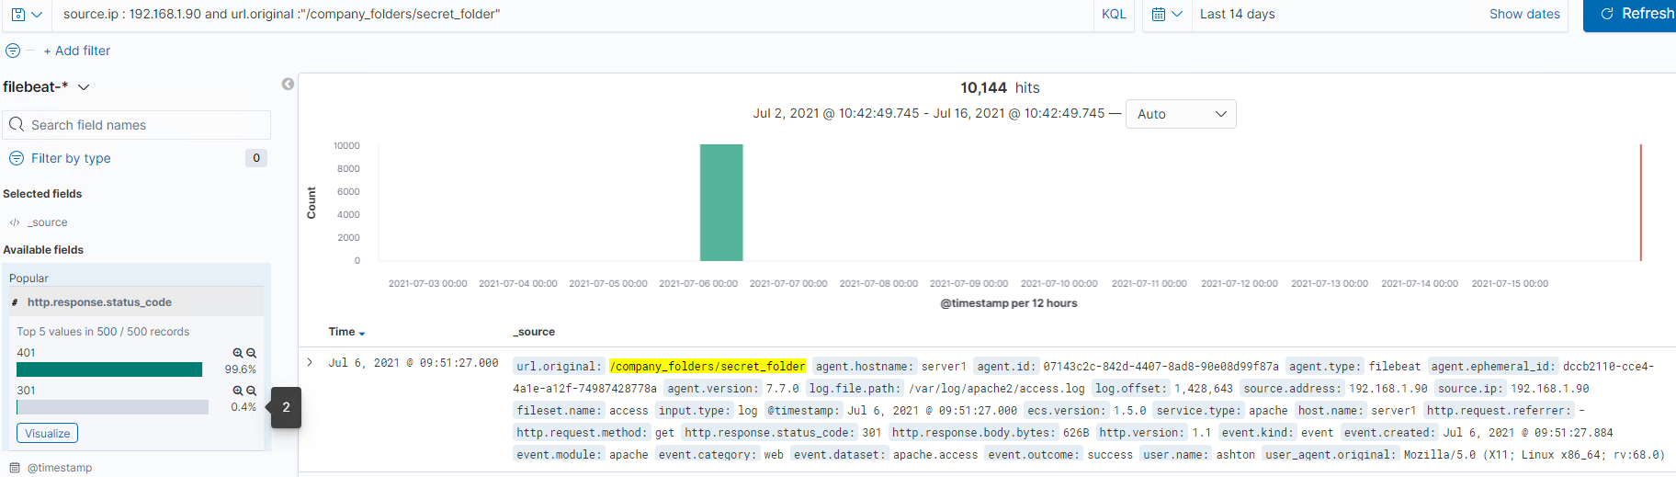
Analysis: Finding the Request for the Hidden Directory
[Insert Here]
Include a screenshot of Kibana logs depicting the request for the hidden directory.
July 6 2021 09:00:00 to 10:00:00 a total of 10,144 requests were made.
2 attempts were successful in accessing the secret_folder.

Slide 14
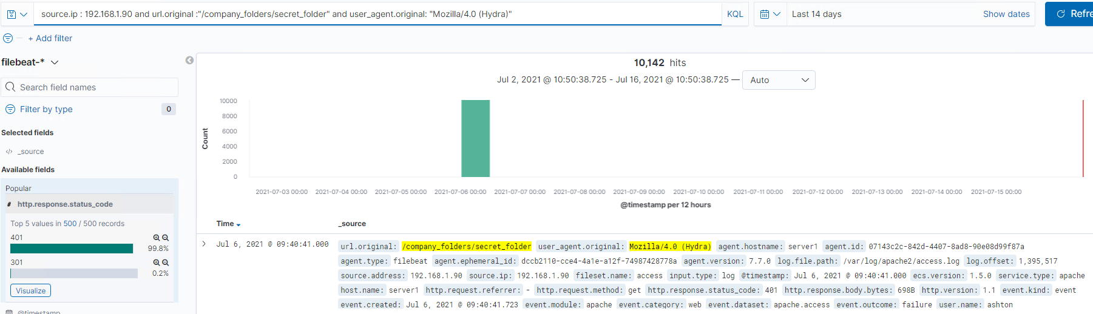
Analysis: Uncovering the Brute Force Attack
[Insert Here]
Include a screenshot of Kibana logs depicting the brute force attack.
10,142 requests were made from hydra, a brute force attack tool
10,141 hits before the password was discovered.

Slide 15
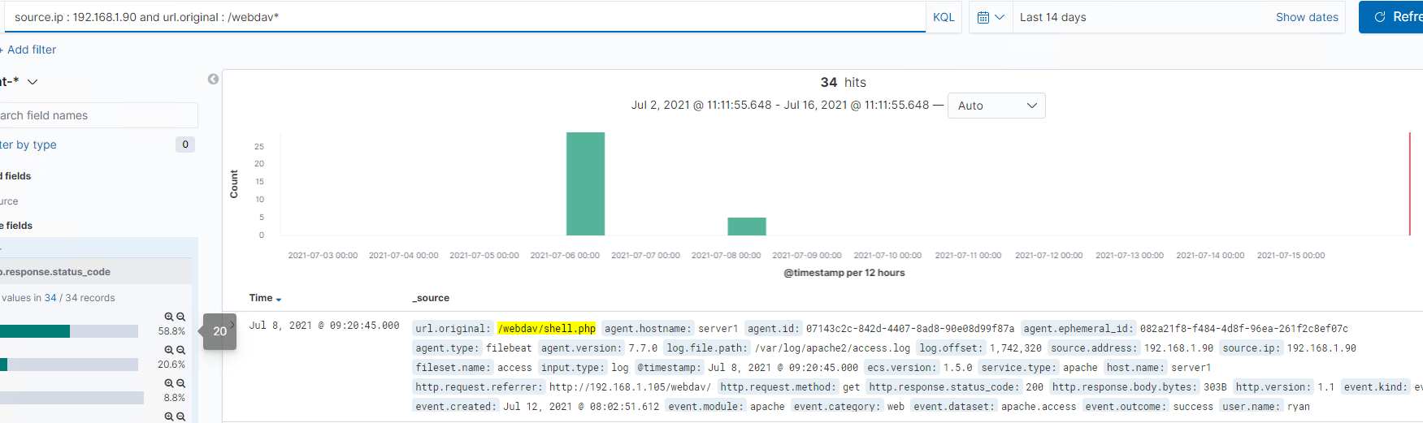
Analysis: Finding the WebDAV Connection
[Insert Here]
Add a screenshot of Kibana logs depicting the WebDAV connection.
34 requests were made to the /webdav directory
The requested of the file password.dav and the placement then access of a payload shell.php

Slide 16
Blue Team
Proposed Alarms and Mitigation Strategies
‹#›

Slide 17
Mitigation: Blocking the Port Scan
What kind of alarm can be set to detect future port scans?
Alert if detecting the nmap user_agent
What threshold would you set to activate this alarm?
If the number of requests exceeds 30
What configurations can be set on the host to mitigate port scans?
Block all requests containing nmap and other known port scanning tools in the user agent. Should an nmap be needed it can be disabled or configured to allow only from host IP..
Describe the solution. If possible, provide required command lines.
Drop if user_agent = *nmap*

Slide 18
Mitigation: Finding the Request for the Hidden Directory
What kind of alarm can be set to detect future unauthorized access?
Request to secret folder and status is not success.
What threshold would you set to activate this alarm?
10 within an hour.
What configuration can be set on the host to block unwanted access?
Remove mention of this directory from error messages when accessing other parts of the site and files.
Redirect to a generic file/resource not found page.

Slide 19
Mitigation: Preventing Brute Force Attacks
What kind of alarm can be set to detect future brute force attacks?
Number of failed logins within an hour.
What threshold would you set to activate this alarm?
8
What configuration can be set on the host to block brute force attacks?
Remove Ashton’s name which gives away the username of the login credentials on the login form.
Enforce stronger password rules so brute forcing is harder. Stronger passwords take longer to brute force.
Lock out the account after multiple failed logins. Prevents login and allows security responder to review the situation.
Enable captcha check after login attempt fails. This helps disrupt automated brute force attempts while only causing minor inconvenience.
Use multifactor authentication

Slide 20
Mitigation: Detecting the WebDAV Connection
What kind of alarm can be set to detect future access to this directory?
Any access attempt and IP is not from whitelist within an hour. Threshold of 10, a bit higher as it might be a scan or a different device/IP.
Upload from non white list IP address. Threshold of 1. Assuming the webdav isn’t used to contain sensitive data this specifically alerts potential upload of attacker payloads.
What configuration can be set on the host to control access?
Do not share accounts.
Do not share passwords or their hashes.
Prevent
Use white list of IP addresses that are allowed to access webdav.
Multifactor authentication.

Slide 21
Mitigation: Identifying Reverse Shell Uploads
What kind of alarm can be set to detect future file uploads?
Monitor connections on port 4444 (common port used for attacks though mostly a convention). Threshold of 1.
Monitor files, uploads and establish baseline. Alert on creation, upload or modification anomalies. (insufficient data to really make a call on what threshold should be).
What configuration can be set on the host to block file uploads?
If not in use disable potentially dangerous php functions such as shell_exec() exec() , passthru(), system(), show_source(), proc_open(), pcntl_exec(), eval(), and assert()
Only allow host to upload file and from specific white list of IP Address.

